Slide 1
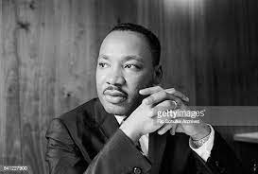
The life and career of Martin Luther King Jr.

Slide 2

The life and career of Martin Luther King Jr.

Slide 3

WHO IS MARTIN LUTHER KING JR?

Slide 4
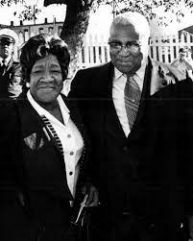
Before we delve into the dream we all know, let’s provide some back story
Shall we?

Slide 5
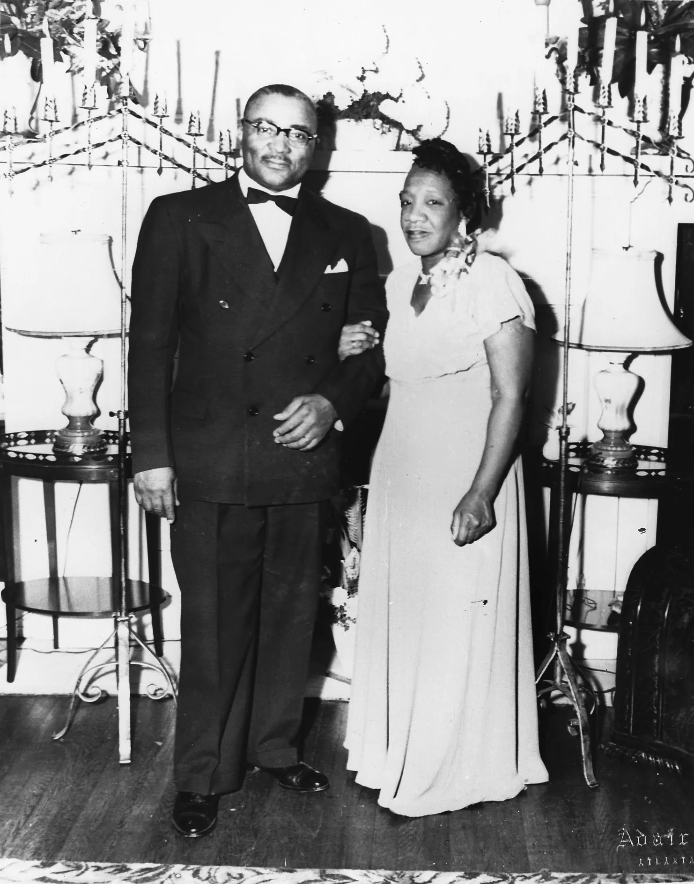
Martin Luther King Jr. was born on January 15, 1929, in Atlanta, Georgia, as Michael King Jr. to Mr. Micheal King Sr. and Mrs. Alberta William King.

Slide 6
Both Martin’s parents & and grandparents were Baptist ministers.
thus, the first 12 years of his life were spent living close to the Ebenezer Baptist Church

Slide 7
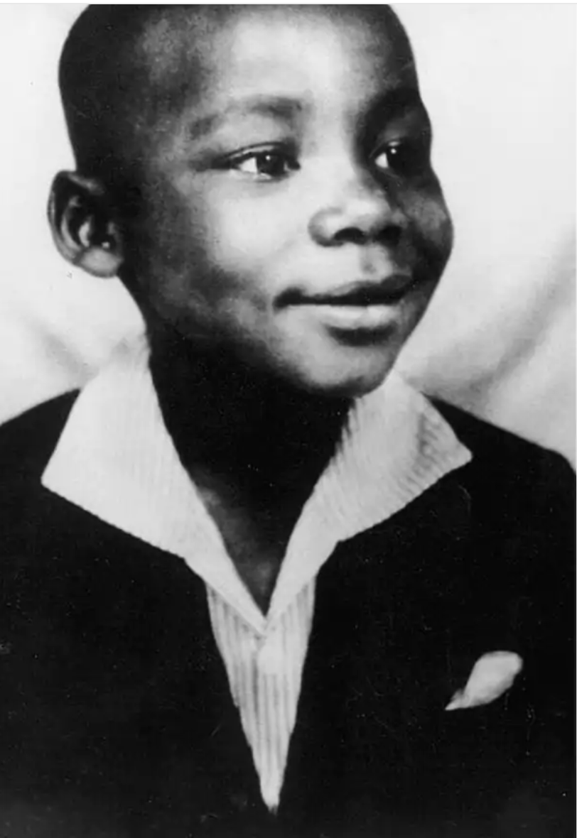
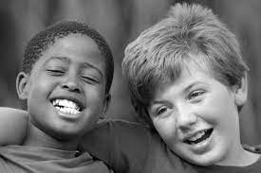
Although Martin had a secure upbringing, it still couldn’t protect him from the prejudice that was then rampant in society.

Slide 8
the experience of losing a playmate simply because of their different colouring became a catalyst that would soon shape whom martin grew to be.

Slide 9
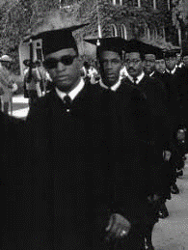
At 15, Martin entered Morehouse College on a special programme designed to boost enrollment by admitting promising high-school students like him.

Slide 10
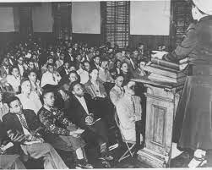
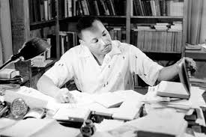
At Morehouse, young Martin took an interest in law and sought to understand the impact it had in influencing and changing society

Slide 11
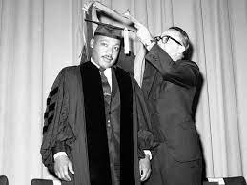
Young Martin also got acquainted with Mays; the then-Morehouse College president.
May’s oratory skills and advocacy for equality deeply resonated with young Martin and he soon became a mentee of the then-president.

Slide 12
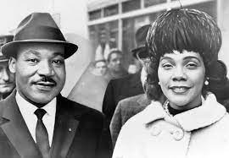
After graduating from Morehouse College. martin continued on to Crozer Theological Seminary, and finally, Boston University for his doctorate degree

Slide 13
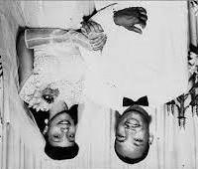
while trying to acquire his doctorate at Boston University, martin met Miss Coretta Scott who was a student of music.

Slide 14
Martin and Coretta got married in 1953.

Slide 15
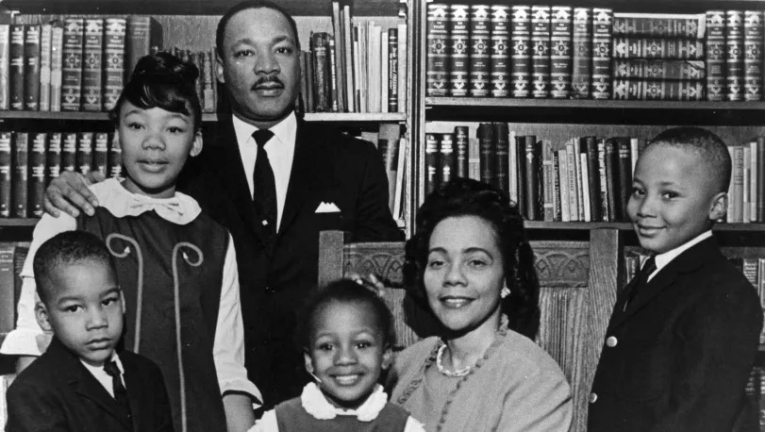
And were blessed with four kids.

Slide 16
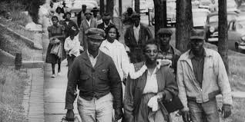
In 1954, martin and his family moved to Montgomery, Alabama and thus the story in itself begun.

Slide 17
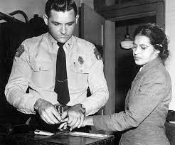
On December 1st 1955, rosa park was arrested for refusing to give her seat to a white passenger thus, violating the city’s segregation law.

Slide 18
After Rosa’s arrest, civil rights activists in Montgomery decided to put an end to racial segregation and boycott the transit system

Slide 19
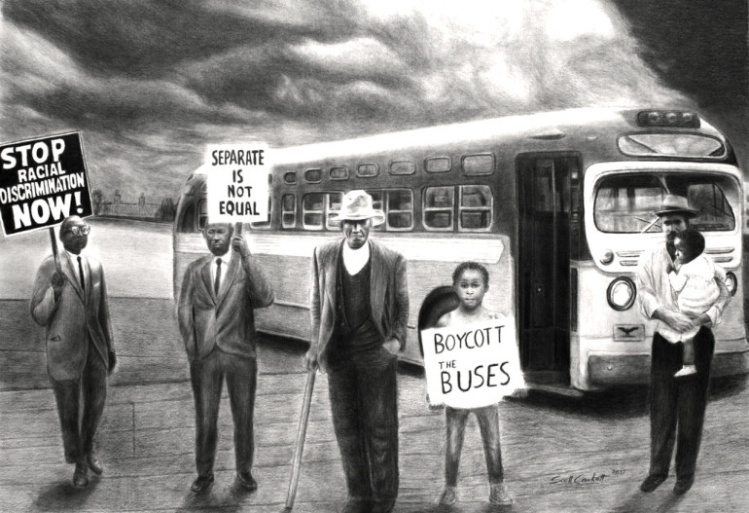
Martin was appointed the president of the Montgomery Improvement Association, and tasked with speaking for and on their behalf.

Slide 20
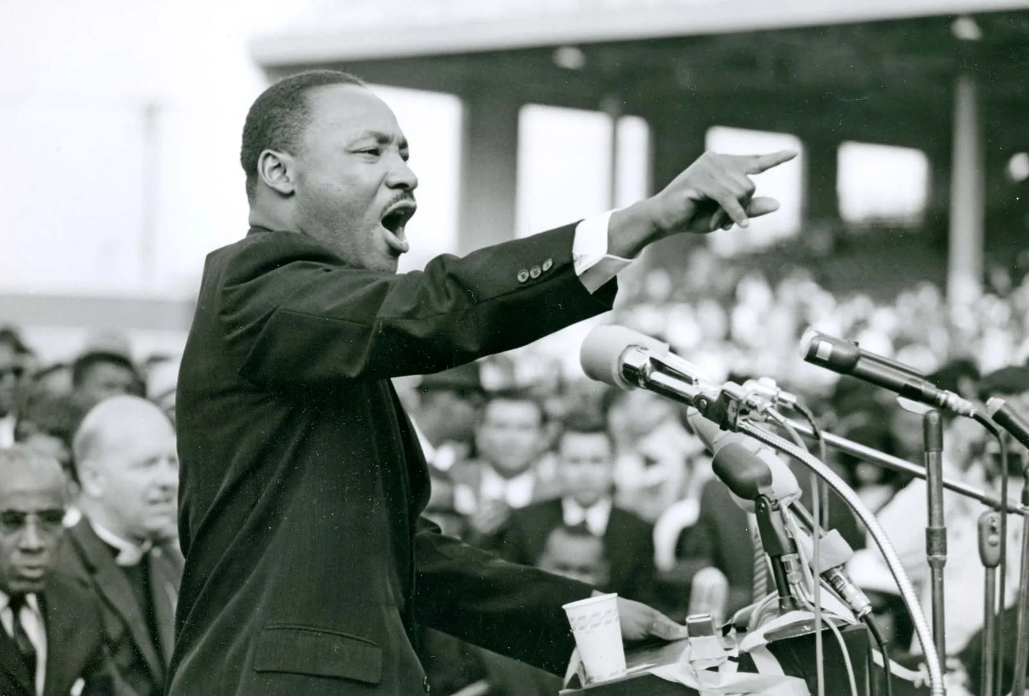

Martin set the tempo of the association’s movement and ultimately, their success with his opening speech

Slide 21
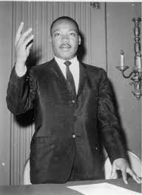
‘We have no alternative but to protest. For many years we have shown amazing patience. We have sometimes given our white brothers the feeling that we liked the way we were being treated. But we come here tonight to be saved from that patience that makes us patient with anything less than freedom and justice.’

Slide 22
On the 13th of November 1956, the U.S. Supreme Court upheld the decision of the lower court in
Browder v Gayle
And stated that indeed the Montgomery & Alabama bus segregation was unconstitutional

Slide 23


On the 17th of May 1957, a few months after the desegregation of Montgomery city buses. Martin was invited to give his first national lecture titled
‘give us the ballot’

Slide 24
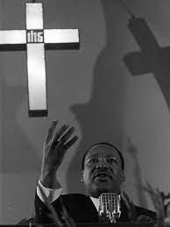
In July 1957, a Few months after the desegregation of Montgomery city buses. martin revisited his birth certificate and changed his government name from Micheal to Martin Luther.

Slide 25
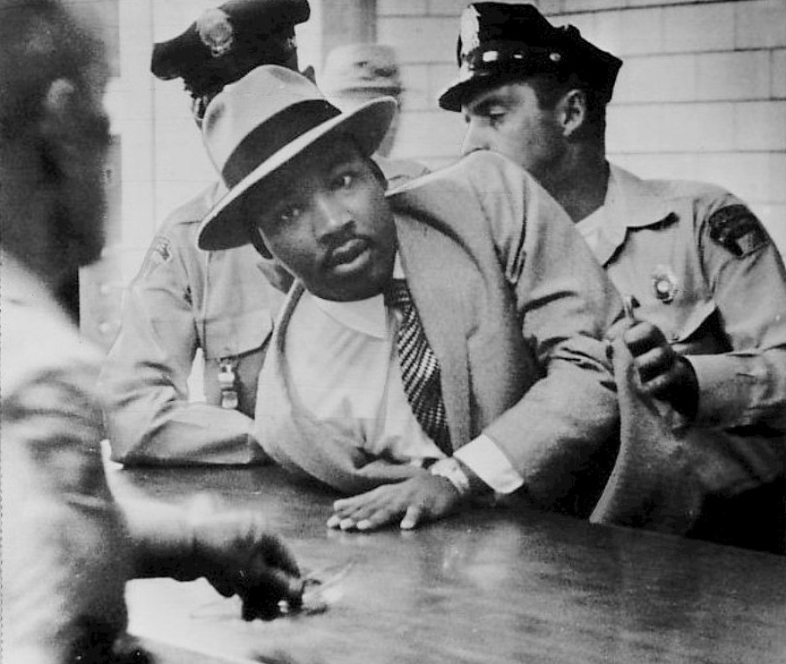
in 1960, King moved to Atlanta, became his father’s assistant pastor and devoted all his time to scls and the civil right movement .

Slide 26
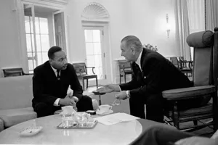
In early October of that same year, King was arrested with 33 young people for protesting segregation at the departmental stores’ lunch counters.

Slide 27
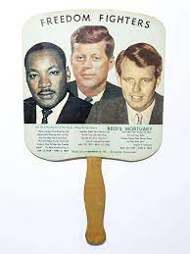
King’s arrest soon gained national attention and upon the intercession of the Democratic presidential candidate; John F. Kennedy he was released

Slide 28

Exactly 8 days after King was released, Kennedy was elected president and thus the wheels were set in motion toward ending racial segregation

Slide 29
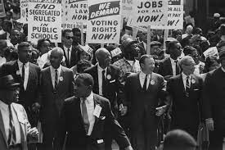
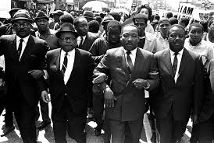
1963 began with King getting arrested yet again as the tension between demonstrators and law enforcement hit an all-time high.

Slide 30

Exactly 4 months after his release.. King made history at the 1963, Washington Freedom March

Slide 31
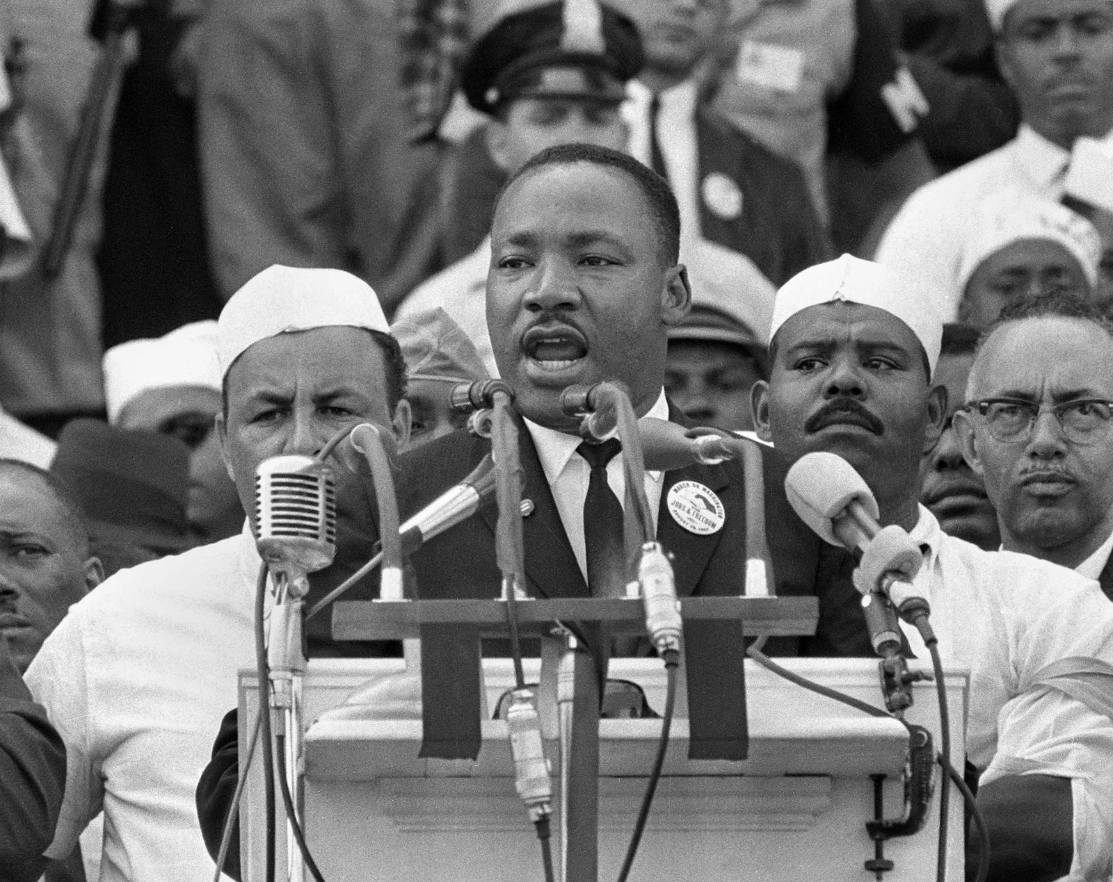
By delivering his ‘I have a dream speech’

Slide 32
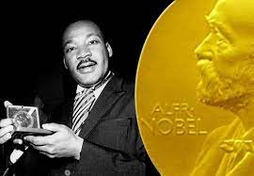
On the 10th of December 1963, King was awarded the Nobel Peace Prize and he pledged every penny of it to the civil rights movement

Slide 33
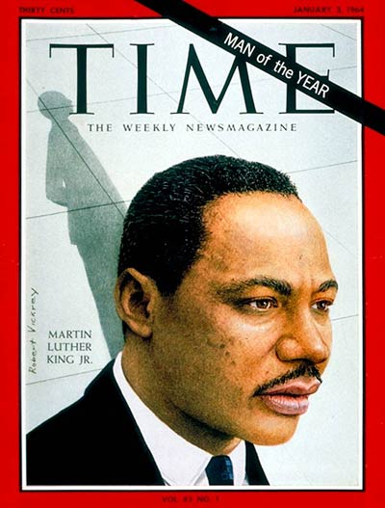
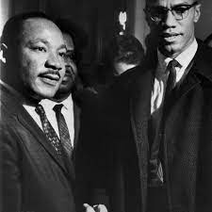
King’s popularity ultimately earned him the 1964 Man of the Year title

Slide 34
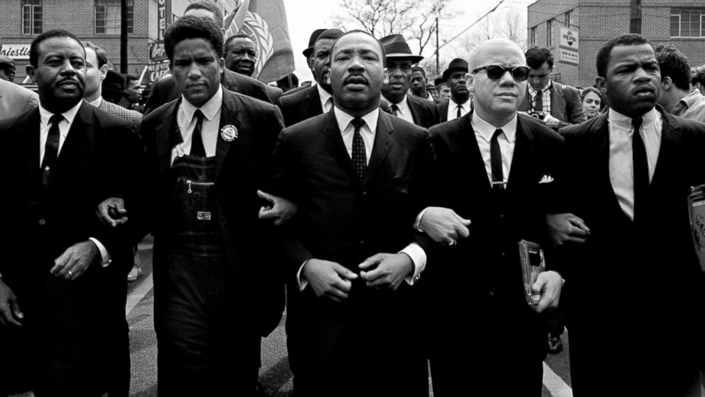
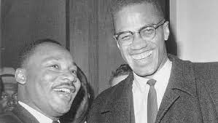
Exactly 3 months after receiving the award. King met Malcolm X for the first and only time

Slide 35
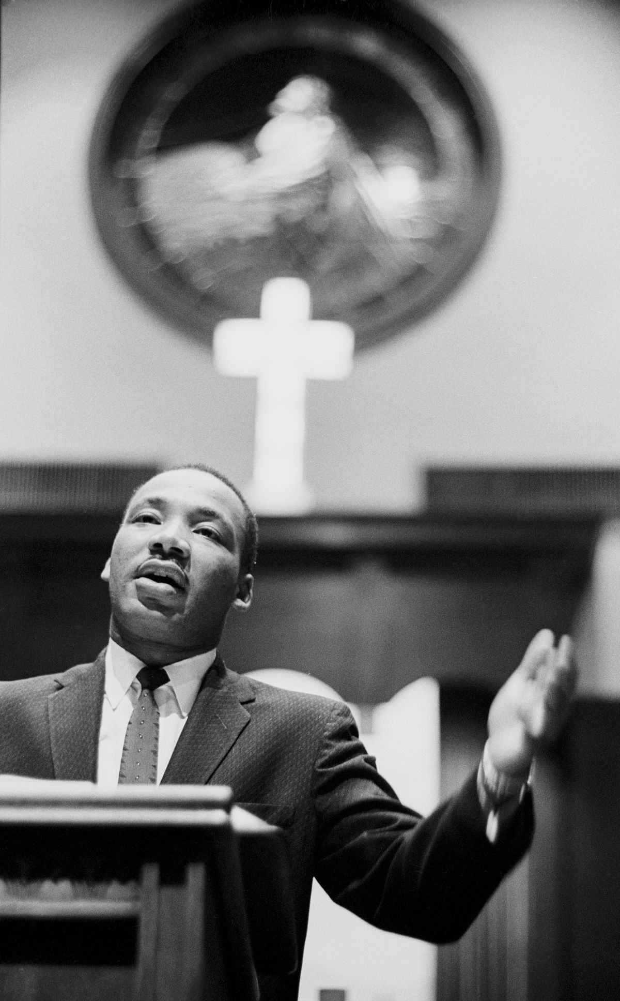
The next two years went in a blur for Martin from
Leading civil rights marchers from Selma to Montgomery after the ruling on the right to conduct orderly marches

Slide 36
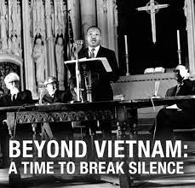
Too using the SCLC convention to publicly oppose the Vietnam War. He kept his spirit high and remained true to his goals

Slide 37
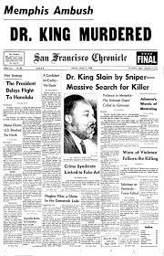
In 1967, Martin was in his artistic element so he published yet another book and delivered yet another speech themed;

Slide 38
Unknown to Martin, his 3rd of April 1968 speech ‘I have been to the mountain top’ would be his last and he was shot the very next day.

Slide 39
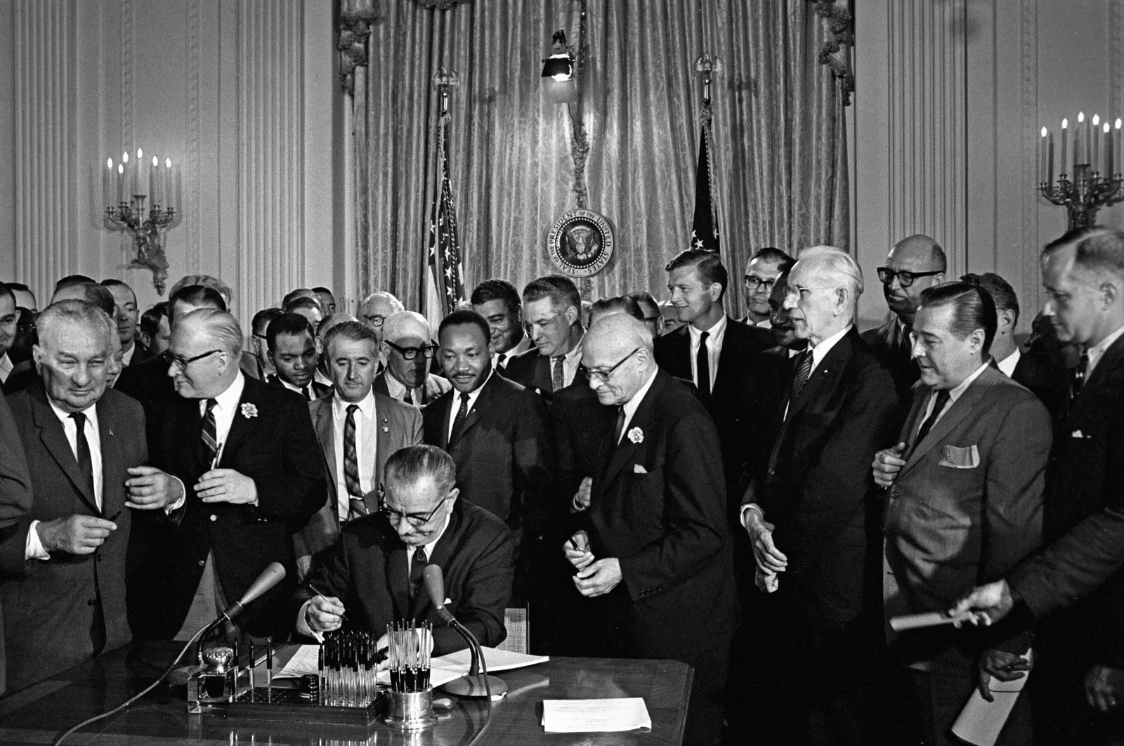
It has indeed all come to an end. But has it …

Slide 40
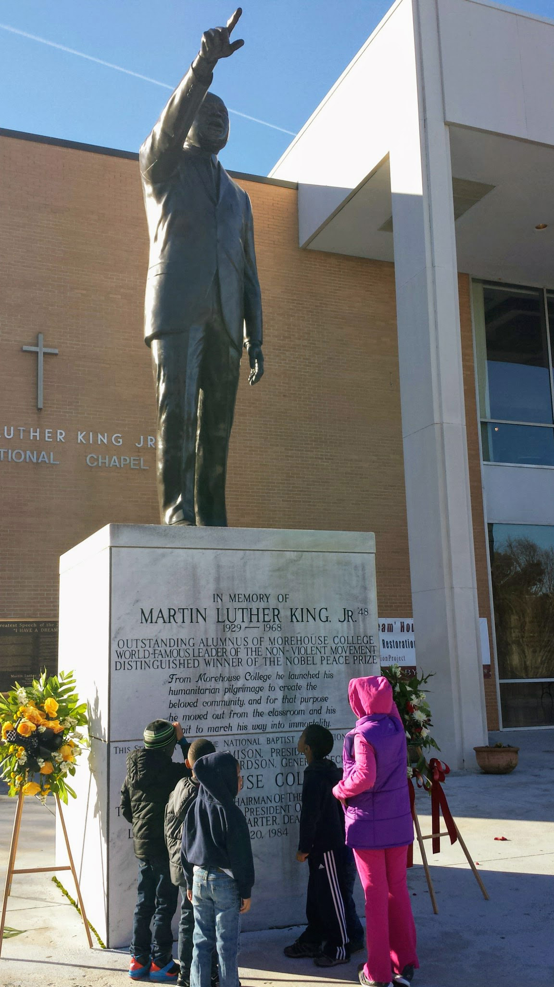
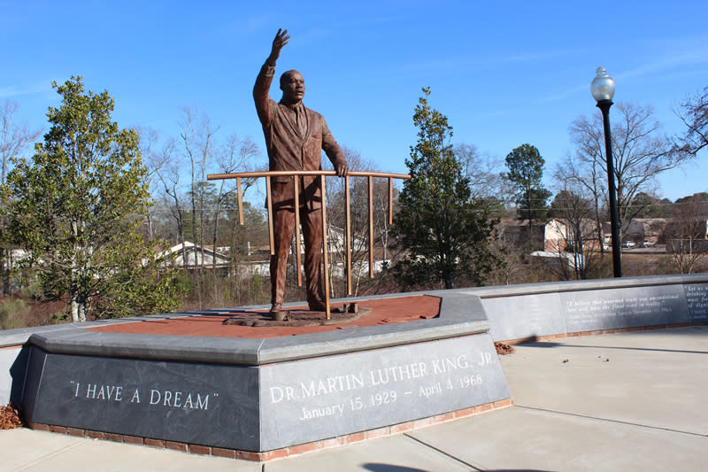
No it hasn’t as his legacy lives on in the
Civil rights act of 1964, the voting act of 1965 and the fair house act of 1968 which he made tremendous contributions too.

Slide 41

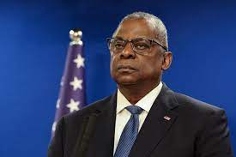
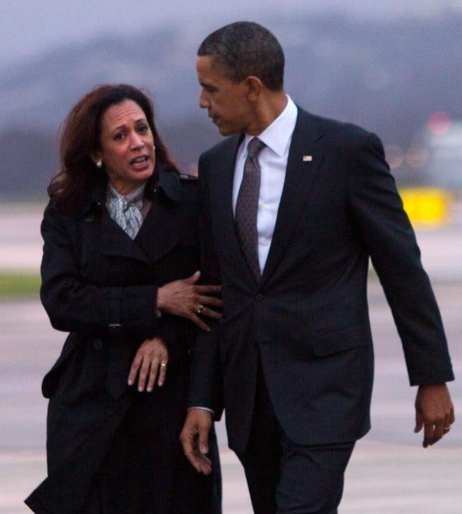
His legacy subsists In the monuments, parks and museums established to continuously remind the world of his impact on equality, segregation outlawing and civil rights movements.

Slide 42
The black leaders in power

Slide 43
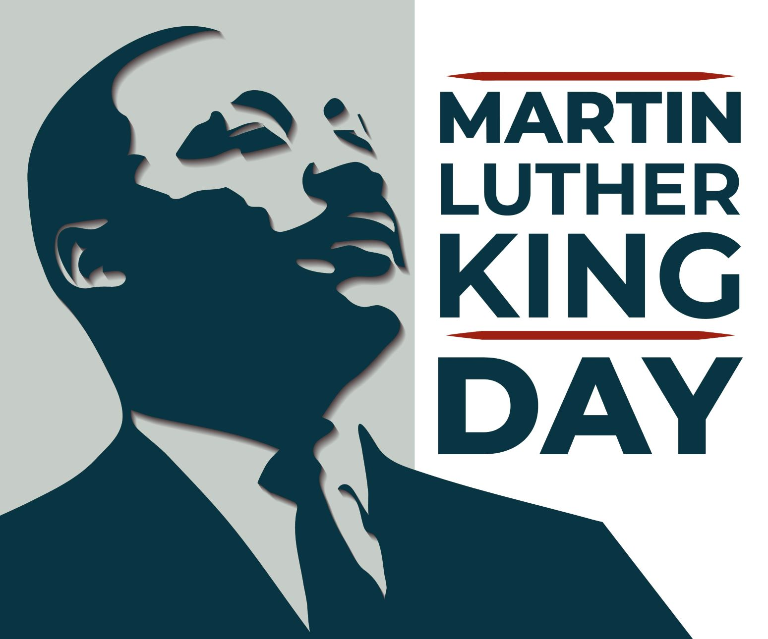
And at the peak of it
The martin Luther king jr. day that we are gathered here to celebrate today.

Slide 44

Thank you for listening

